Slide 1
Cardboard X2 200g
60 grit Sandpaper

Slide 2

Sandpaper 60

Slide 3
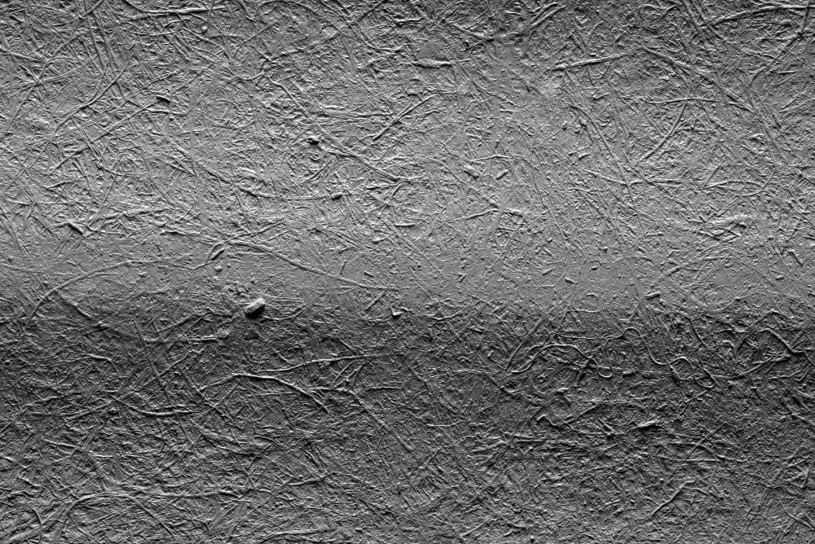
0

Slide 4

200

Slide 5
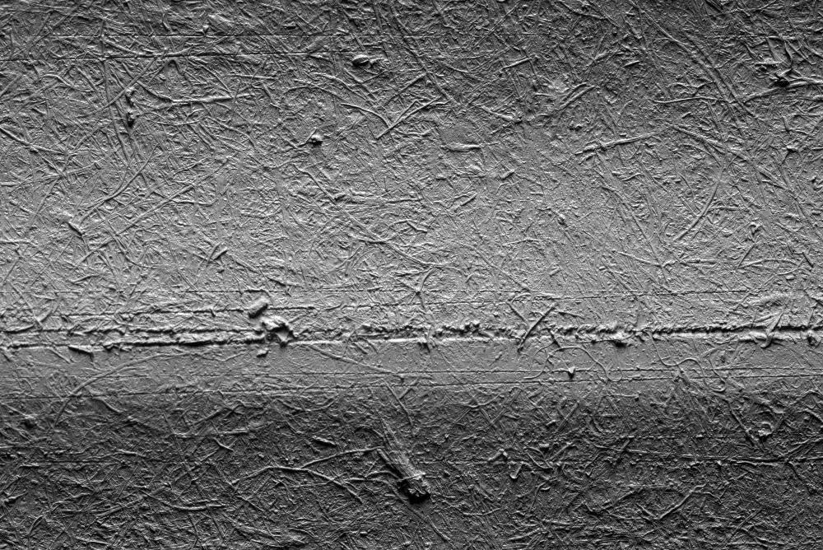
400

Slide 6
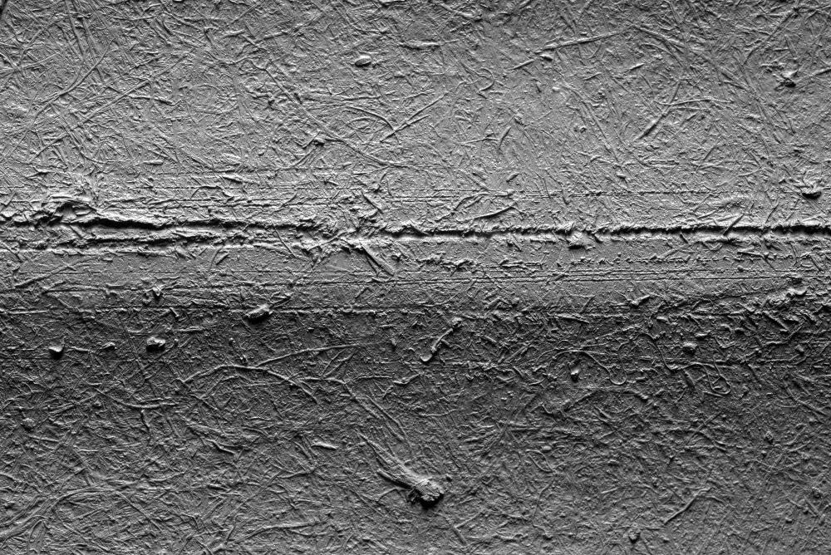
800

Slide 7
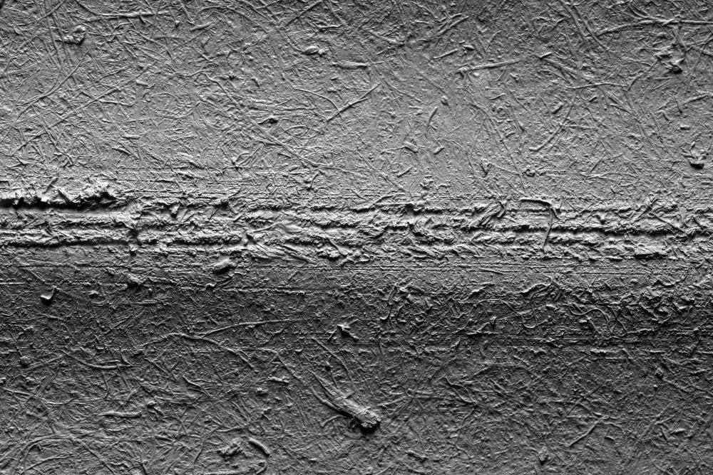
1200

Slide 8
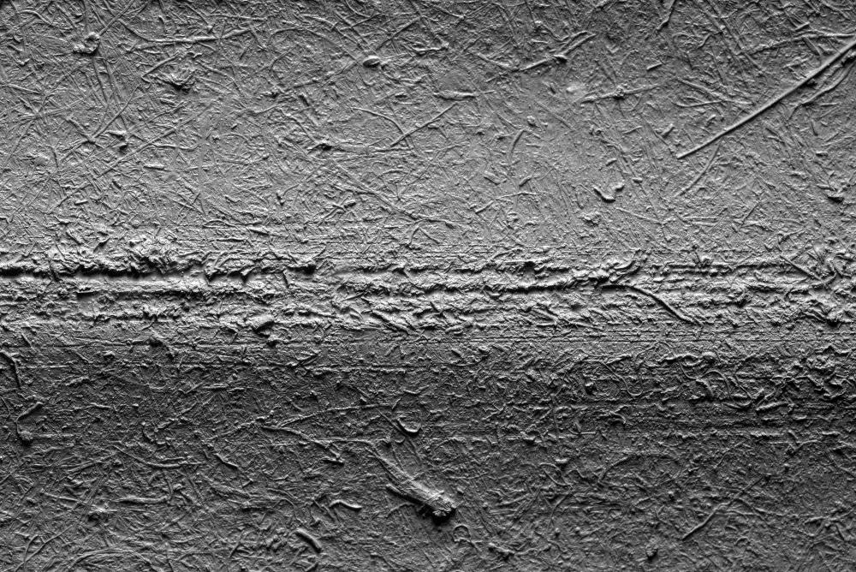
1600

Slide 9
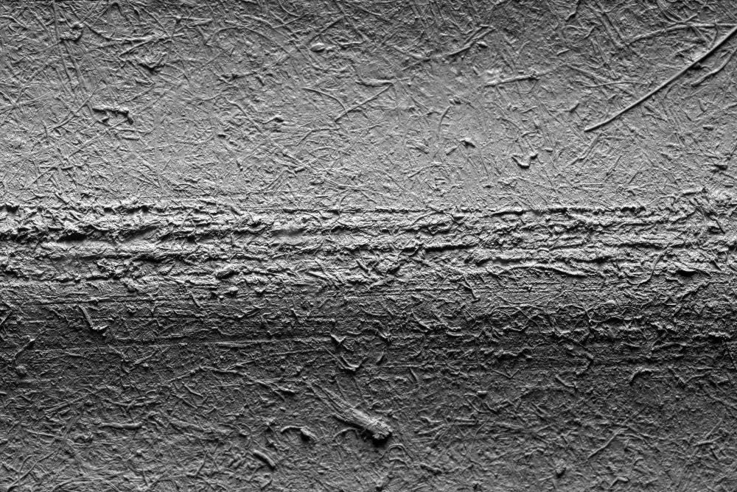
2000

